Slide 1
JAVASCRIPT TASKS
DOM · Events · Forms
Frontend Web Developer Training

Slide 2
TASK 1 — PART 1
Shopping Store
Create a simple Shopping Store page
using HTML, CSS, and JavaScript.

Slide 3
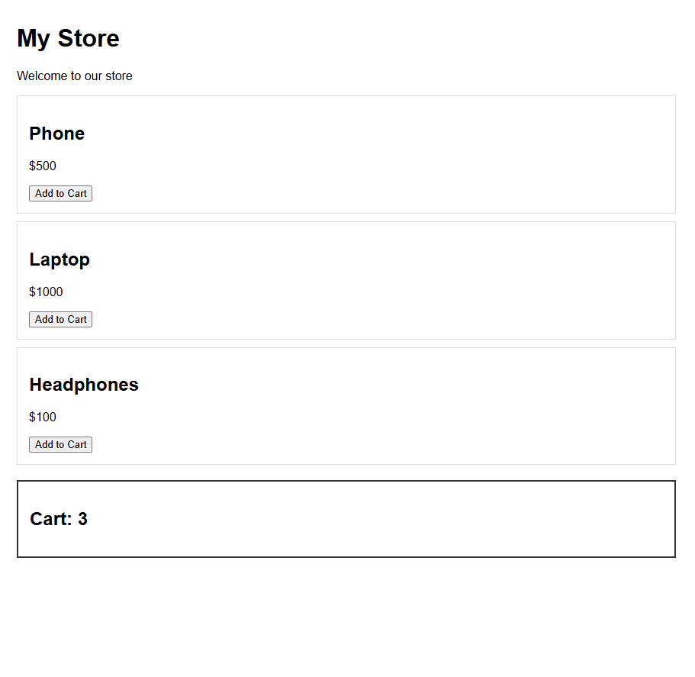
TASK 1 — PART 1 · Shopping Store
Requirements
1. Create a page with:
• A title: My Store
• A welcome message.
• Three products.
• An Add to Cart button for each product.
• A cart section.

Slide 4
TASK 1 — PART 1 · Shopping Store
Requirements
3. Use JavaScript to select:
• The welcome message.
• All Add to Cart buttons.
• The cart section.
• The cart number.
4. Print all Add to Cart buttons in the console.
5. Change the welcome message using textContent.
6. Use innerHTML to show a message inside the cart.
7. Use classList to add and remove classes from the cart.
8. Use style to change the cart message color.

Slide 5
TASK 1 — PART 2
Add Events to the
Shopping Store
Use the same Shopping Store from Task 1.
Do not create a new page.
Add the new JavaScript features to your existing code.

Slide 6
TASK 1 — PART 2 · Add Events
Requirements
1. When the user clicks the Checkout button:
• Print "Redirecting to payment gateway...".
• Print the clicked element using event.target.
2. Add a search input
3. When the user types in the search input: Print the current value in the console.
4. Add a country select
5. When the user changes the country: Print "Country changed, calculating new shipping fees...".
6. When the user presses Enter inside the search input: • Print "User hit Enter! Submitting search..."

Slide 7
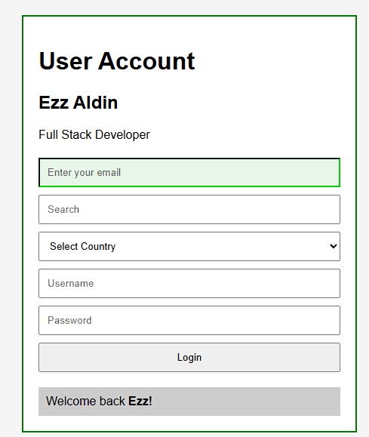
TASK 2
User Account & Login
Create a User Account page using
HTML, CSS, and JavaScript.

Slide 8
TASK 2 · User Account & Login
Requirements
1. Create a page with:
• A user name.
• A user description.
• An email input.
• A search input.
• A country select.
• A login form.
• A login button.
• A notification area.

Slide 9
TASK 2 · User Account & Login
Requirements
2. Use JavaScript to select all required elements.
3. Change the user name using textContent.
4. Change the description using textContent.
5. Use innerHTML to show a notification with an HTML element.
6. Use style to change the email input border and background color.
7. Use classList to add and remove classes from the profile.

Slide 10
TASK 2 · User Account & Login
Requirements
8. When the user types in the search box:
• Print the current value in the console.
9. When the user presses Enter inside the search box:
• Print "Search submitted!".
10. When the user changes the country:
• Print "Country changed!".

Slide 11
TASK 2 · User Account & Login
Requirements
11. When the user clicks the login button:
• Print "Login button clicked!".
• Print the clicked element using event.target.
12. When the login form is submitted:
• Stop the page from reloading using preventDefault().
• Print "Form data captured via JS without page reload!".

